Slide 1
Concepts in Supervised Learning
Instructor: Mohammad Hasan
Office: 13-240
09/14/26
Notes:
Welcome and Introductions

Slide 2
Overview
Statistics and Probabilities Review
Bias-Variance Decomposition

Slide 3
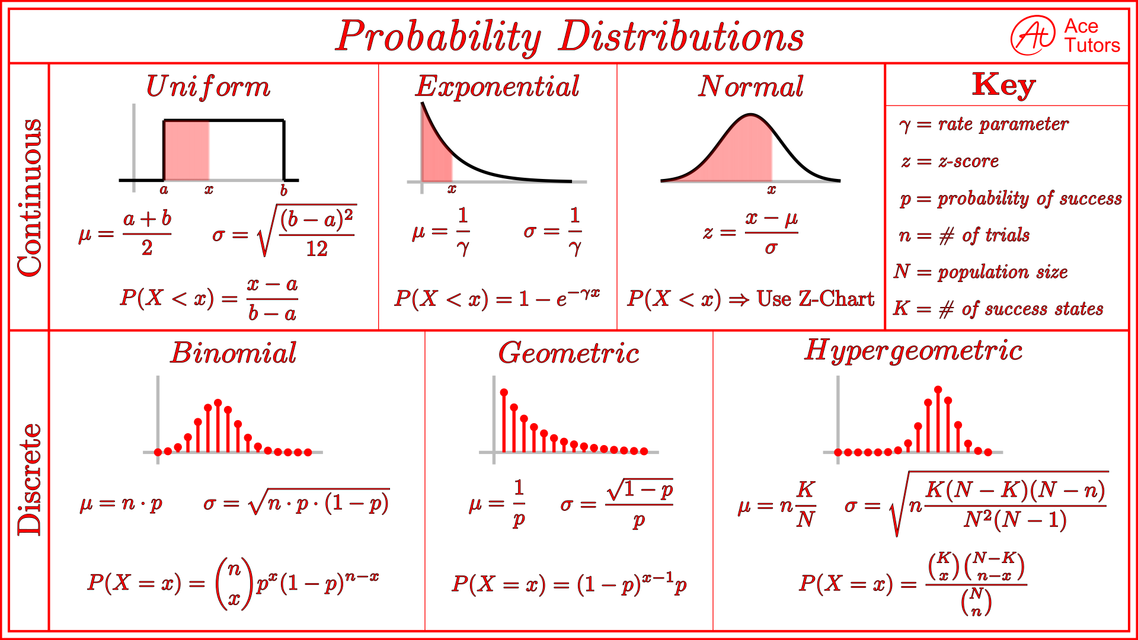
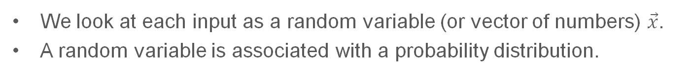
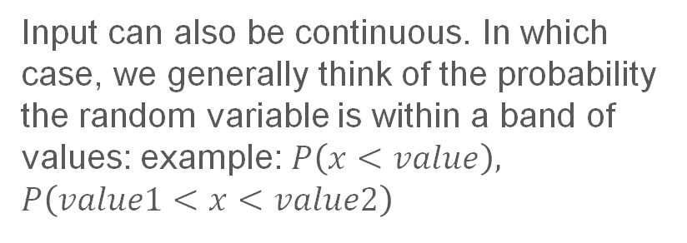
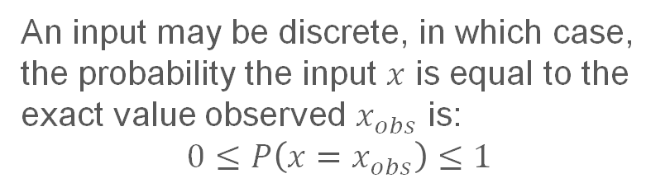
Statistics and Probabilities
We look at each input as a random variable (or vector of numbers) $\vec{x}$.
A random variable is associated with a probability distribution.
An input may be discrete, in which case, the probability the input $x$ is equal to the exact value observed $x_{obs}$ is:
$$0≤P\left(x=x_{obs}\right)≤1$$
Input can also be continuous. In which case, we generally think of the probability the random variable is within a band of values: example: $P\left(x<value\right), P\left(value1<x<value2\right)$

Slide 4




















Statistics and Probability
Expected value of a random variable:

Slide 5
General Assumptions in Supervised Learning
Statistical Assumptions:
Inputs are iid (independent and identically distributed)
Triplet of: beam deformation, beam length and beam strain are not independent. One should be removed.
Identically Distributed: Every row of data is assumed to be taken from the same probability distribution.
Data is well representative of the overall system behavior

Slide 6







Variance-Bias Decomposition

Slide 7











Variance-Bias Decomposition

Slide 8
Variance-Bias Trade-off
Bias is a measure of accuracy of our predictions.
Variance is a measure of consistency of predictions (and the nonlinearity/waviness of our prediction function)
Errors in machine learning are generally a combination of the effects of bias and variance.

Slide 9
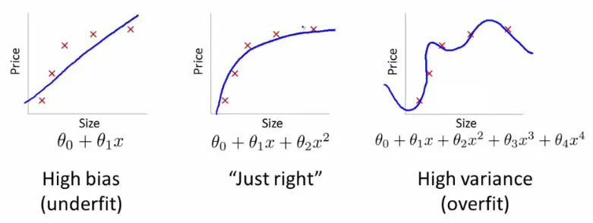
Variance-Bias Trade-off
As models get more complex and nonlinear, we move from high bias models, to high variance models.
Usually, weak models → high bias → underfitting the data (we are not following the shape of the data well).
Very powerful models → high variance → overfitting the data (we are tracing the data too much and may be over-representing the effects of noise and uncertainty.
There is a sweet spot!

Slide 10
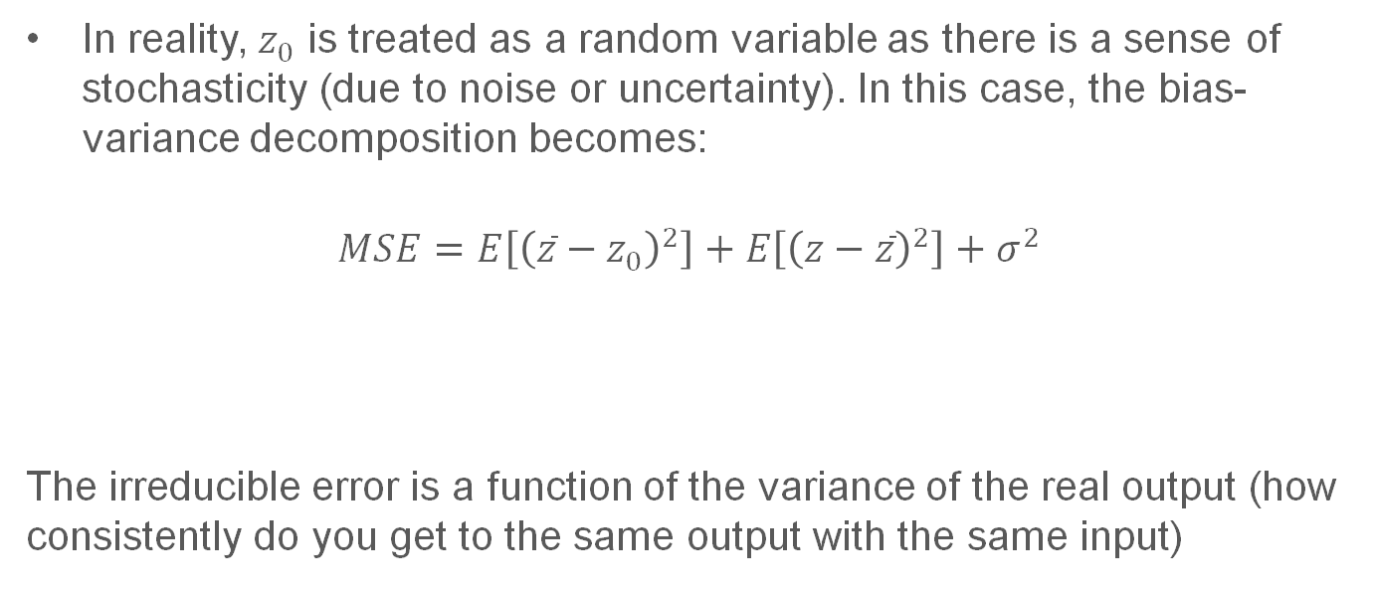
Output Variable as a RV
In reality, $z_{0}$ is treated as a random variable as there is a sense of stochasticity (due to noise or uncertainty). In this case, the bias-variance decomposition becomes:
$$MSE=E\left[{\left(\overline{z}−z_{0}\right)}^{2}\right]+E\left[{\left(z−\overline{z}\right)}^{2}\right]+σ^{2}$$
The irreducible error is a function of the variance of the real output (how consistently do you get to the same output with the same input)
Variance
Bias²
Irreducible error

Slide 11
References
Materials from this slides (slide 6 – 10) used Machine Learning, A First Course for Engineers and Scientists by Lindholm et. al (March 4th, 2026 version), section 4.4 as a reference. Access to this document is free at the publishers’ GitHub page.

